Slide 1

Hotel Reservation Cancellation Prediction
Aparna Raghavendra Rao

Slide 2
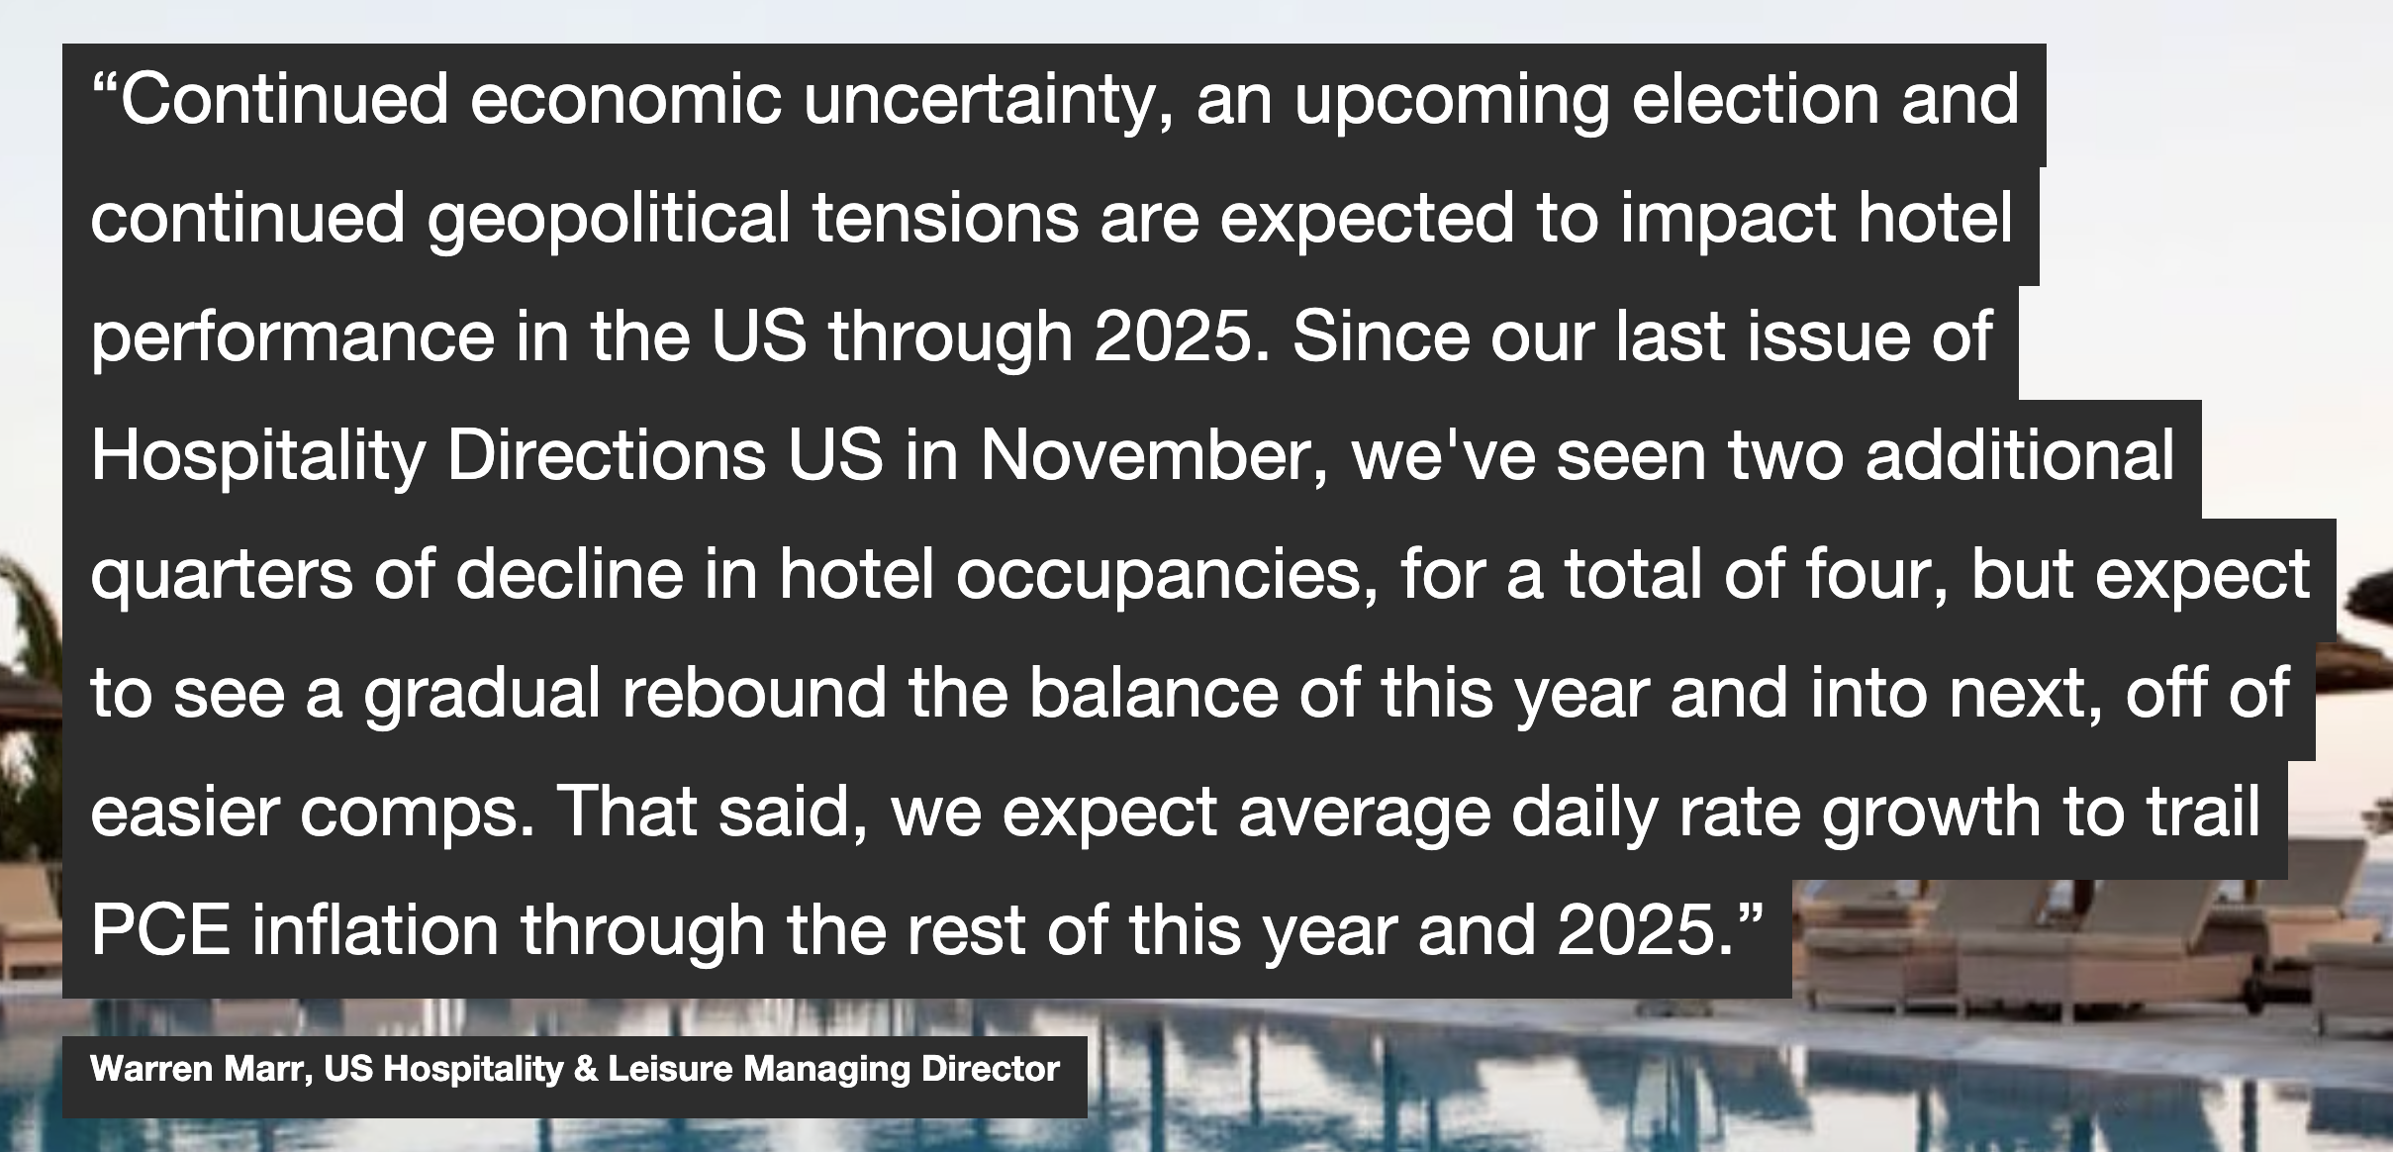
Why is analytics important in the hospitality industry?
Source: US Hospitality Directions May 2024 PwC Report

Slide 3
Why is analytics important in the hospitality industry? – Impact of cancellations
Lower occupancy = lower revenue
Hotel’s ranking drops on Online Travel Agencies’ (OTAs) websites (Ex: Expedia, Booking.com)
Operational issues – last minute planning, extra work, and added stress
Source: Everything you need to know about Hotel Cancellations

Slide 4
The solution is simple: data analytics
Answer questions like:
Which booking channels are most popular?
Which time of the year is the busiest?
Customer’s feedback?
Areas of improvement?
How to manage our inventory?
How to decide staff schedule?
… and so on
Source: The Use of Data Analytics in the Hospitality Industry

Slide 5
Data and Exploratory Data Analysis
Project & Dataset Description
Exploratory Data Analysis

Slide 6
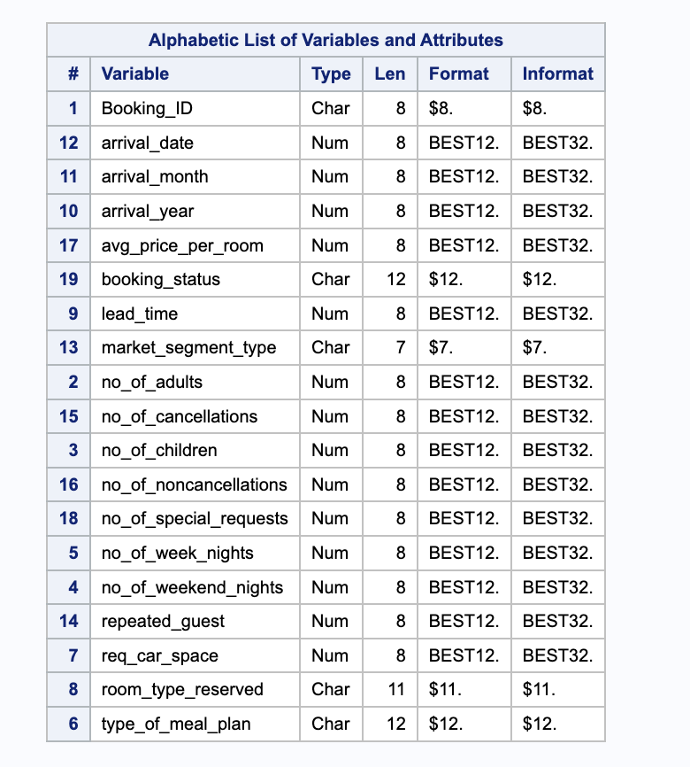
Project & Dataset Description
End User: Hoteliers
Final Output: SAS Code to predict cancellations & non-cancellations
Dataset used: Hotel Reservations Dataset from Kaggle.com
About the data: 36276 rows and 19 columns
Target Variable: booking_status with two possible values – canceled & not_canceled

Slide 7
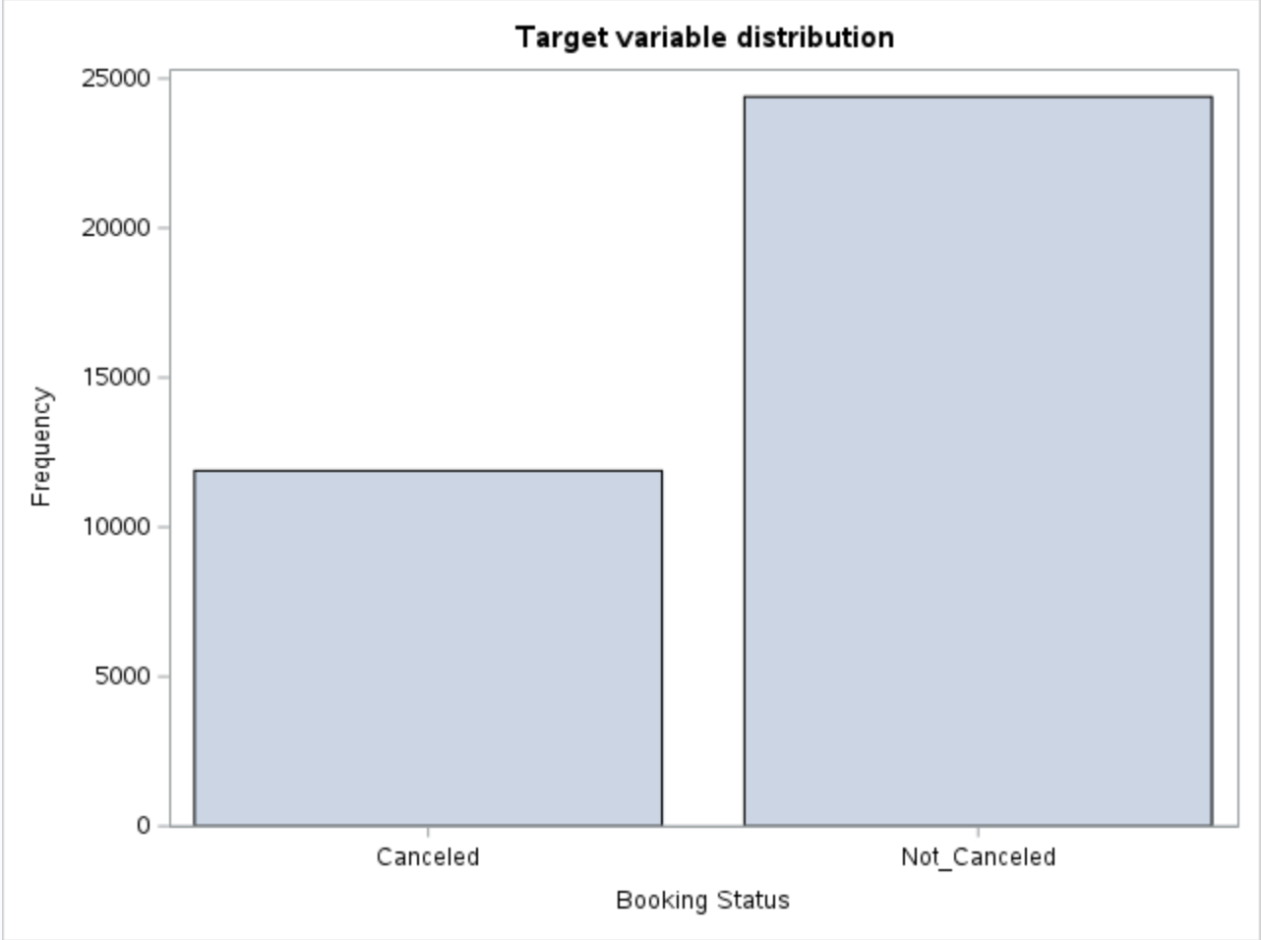
Exploratory Data Analysis
Change variable names to make it SAS-friendly
Check average values
Check for missing values
Drop booking id column
Check variable distributions
Visualize data

Slide 8
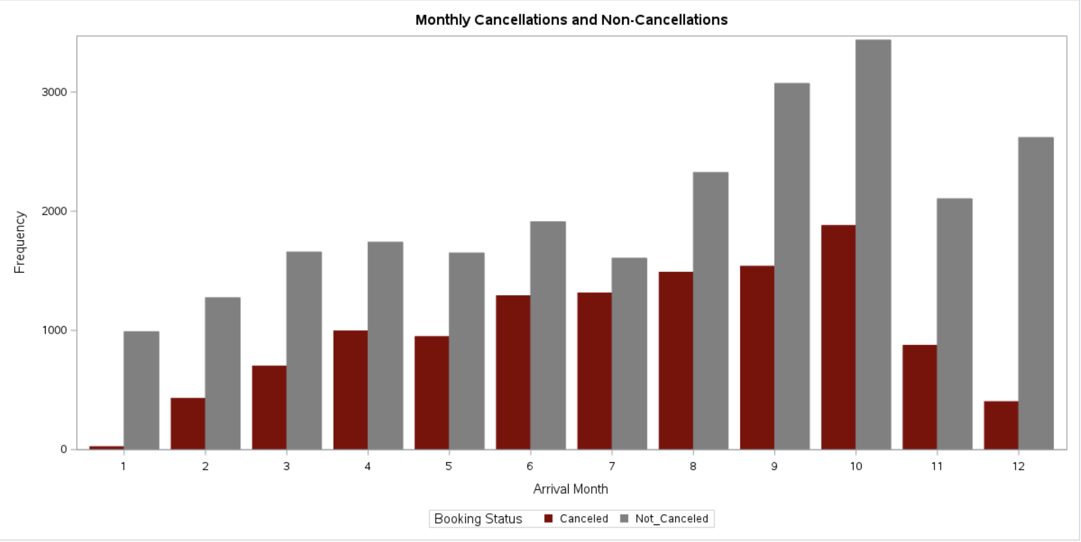
Cancellations increase in summer & fall months

Slide 9
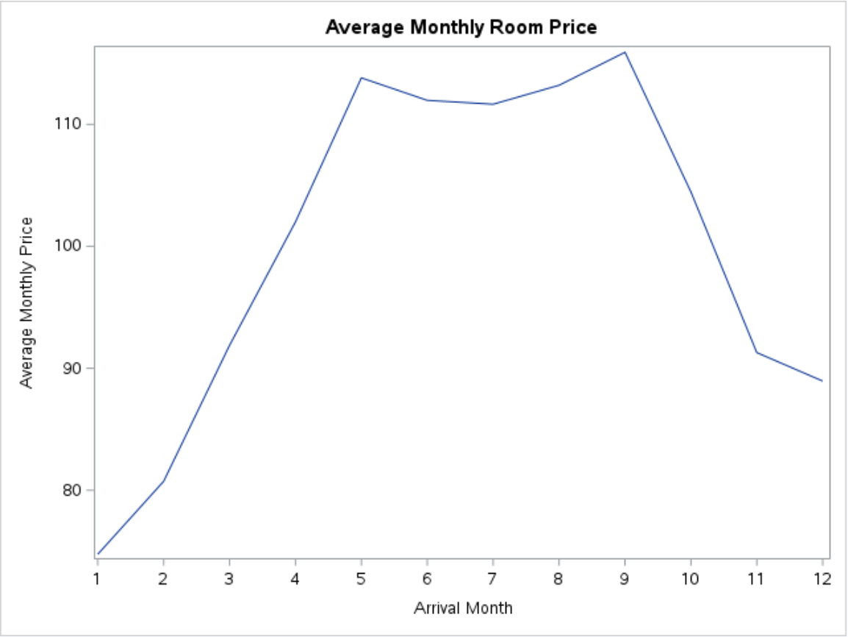
Average Room Prices are highest in spring, summer & fall months

Slide 10
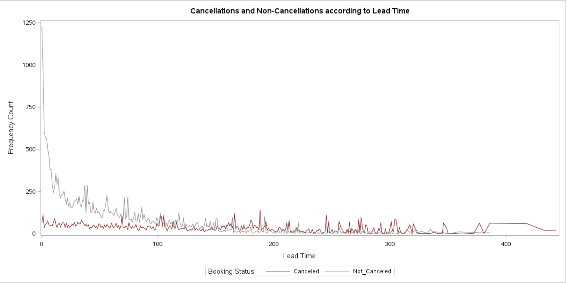
Customers are less likely to cancel with approaching arrival date
Lead time = number of days between date of booking & arrival date

Slide 11
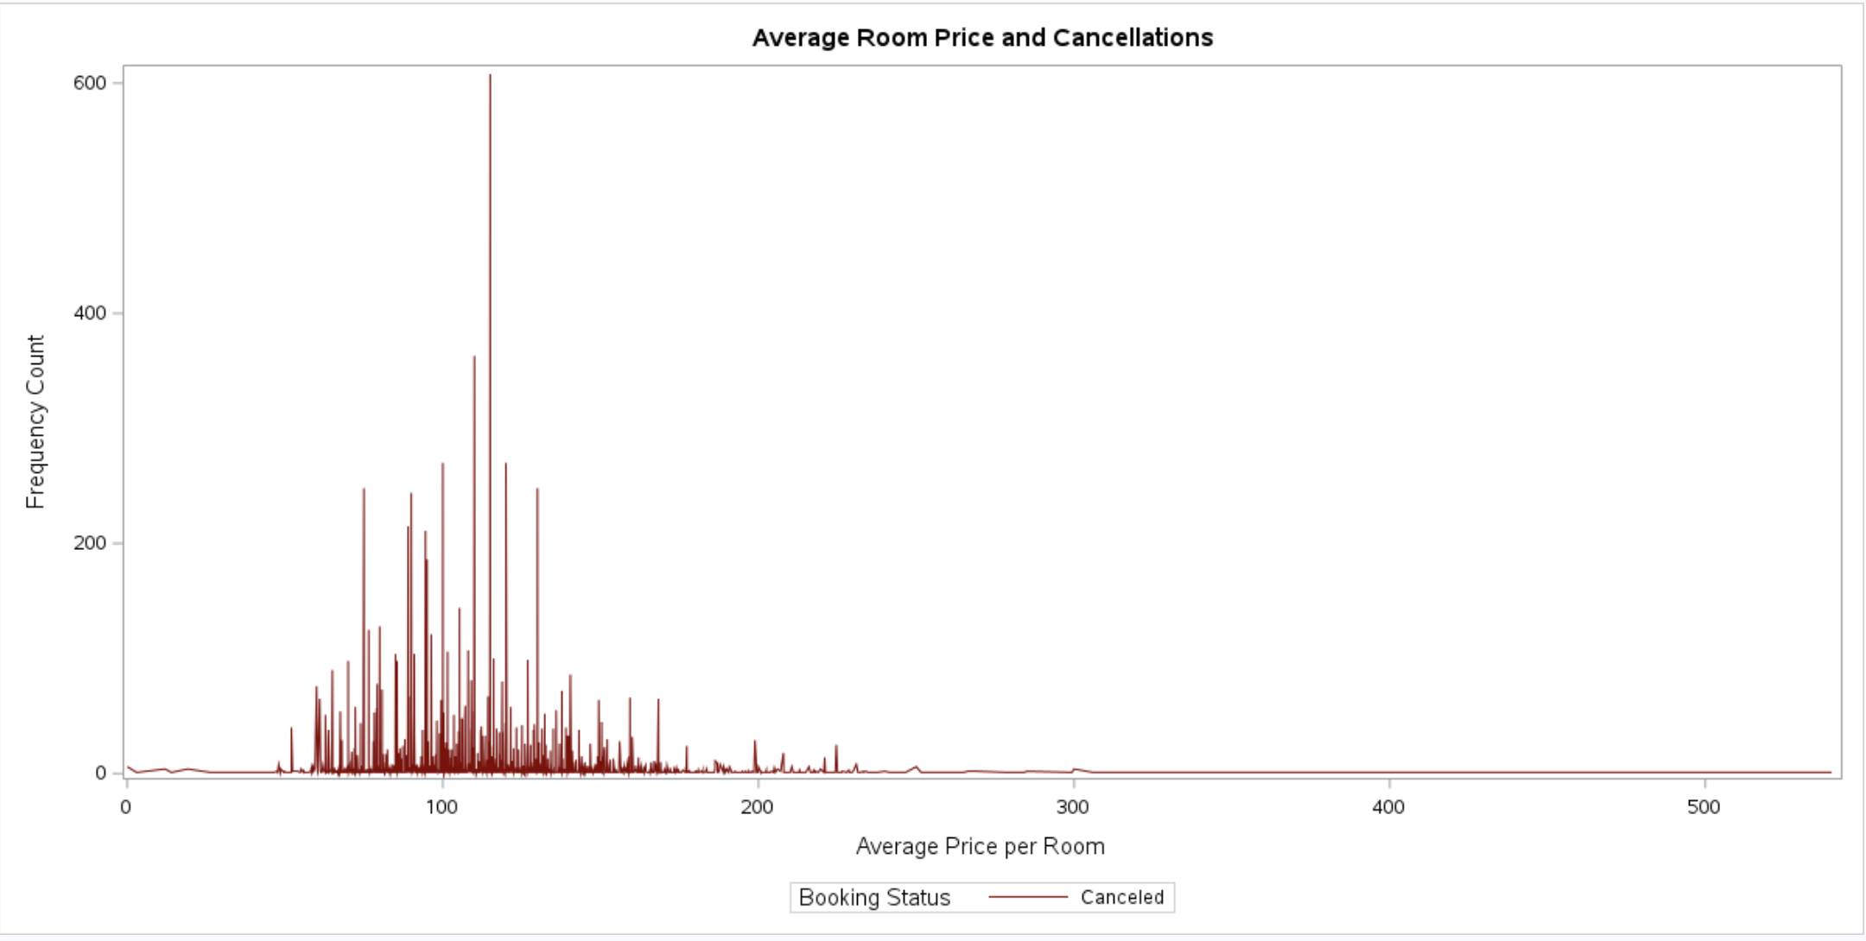
Most cancellations happen when the average price of rooms is between 100-150 Euros

Slide 12
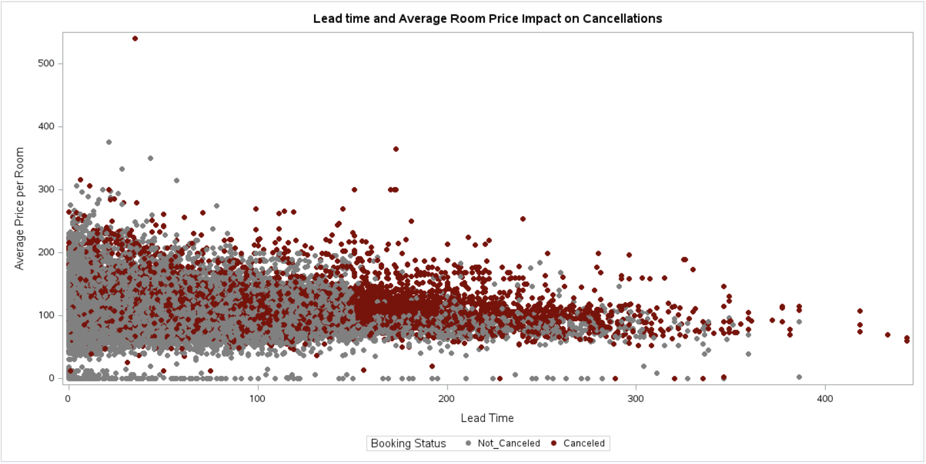
Cancellations are not only influenced by average price. What are the other factors?

Slide 13
Analysis & Modeling
Simple Random Sampling versus Stratified Sampling
Logistic Regression Output
Model Evaluation: Confusion Matrix
Limitations & Future Scope

Slide 14
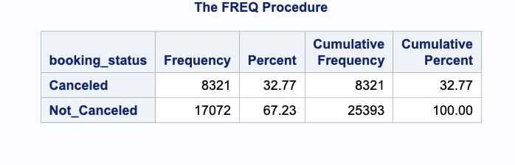
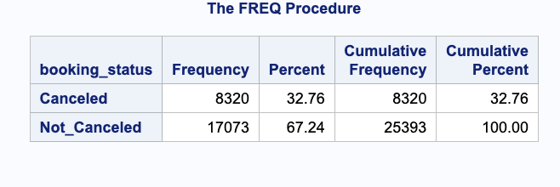
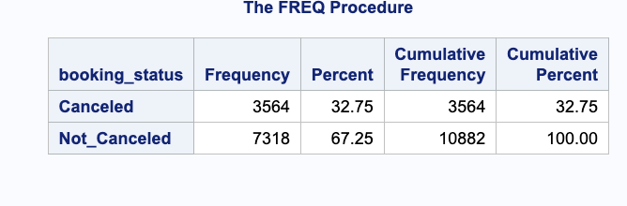
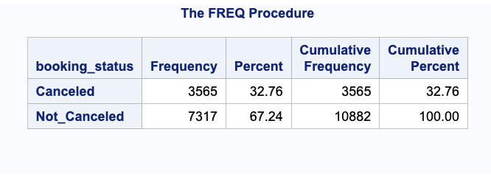
Simple Random Sampling versus Stratified Sampling
Stratified Sampling
Simple Random Sampling
Training set:
Test set:
Training set:
Test set:

Slide 15
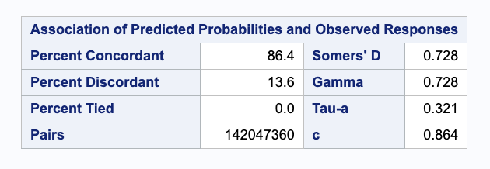
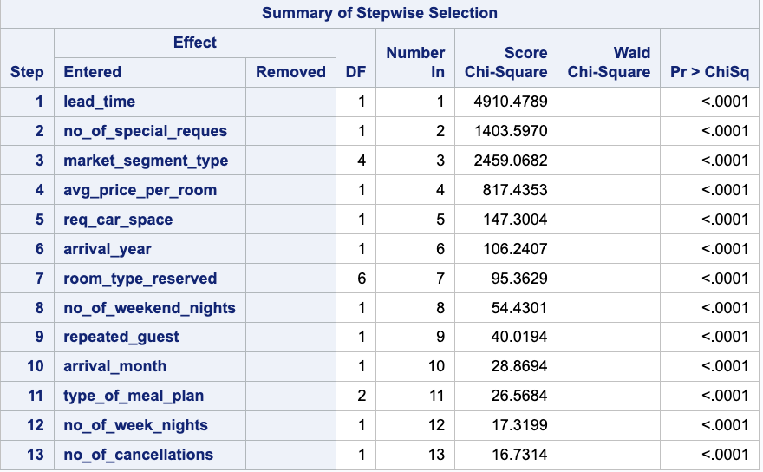
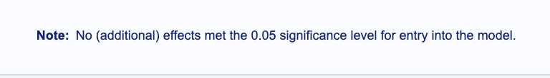
Logistic Regression Output
Higher the concordance, larger the separation between good and bad accounts; how well the model’s prediction matches the actual outcome.
P-value is small indicating variable is statistically significant.

Slide 16
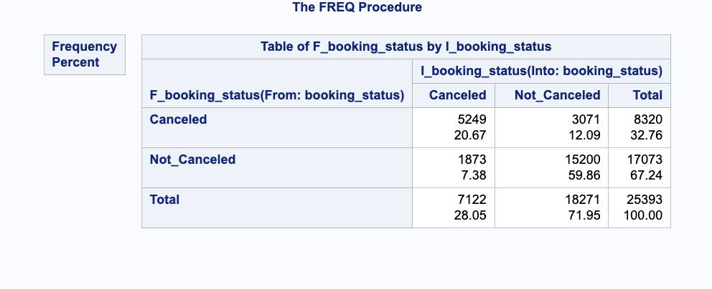
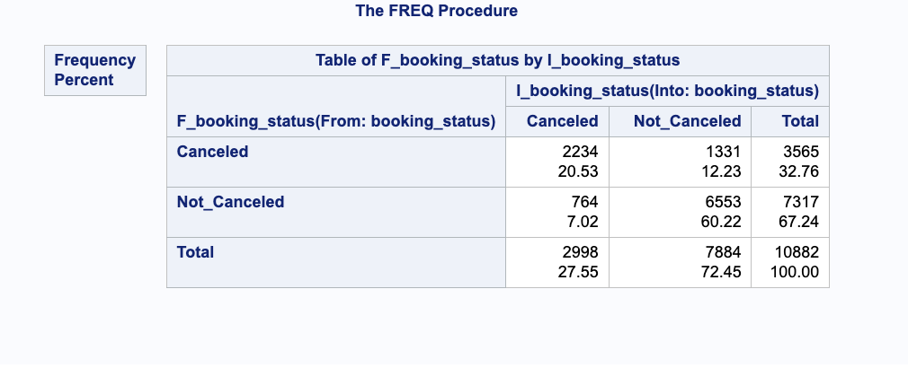
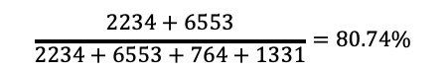
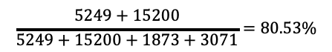
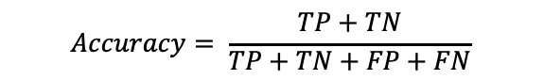
Model Evaluation: Confusion Matrix
Train
Test
Predicted
Actual
$$Accuracy= \frac{TP+TN}{TP+TN+FP+FN}$$
$$\frac{5249+15200}{5249+15200+1873+3071}=80.53\%$$
$$\frac{2234+6553}{2234+6553+764+1331}=80.74\%$$

Slide 17
Limitations and Future Scope
Limitations:
Modeling in SAS is a learning curve
Using the model has a learning curve from end user’s point of view
Future Scope:
Build other models and compare results
Add in detailed explanation of code snippets to make it easier for end user

Slide 18
Thank you!
Do you have any questions?

